Slide 1
Function Calling Procedure
07/05/2021

Slide 2
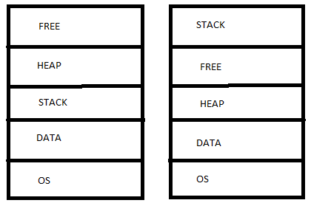
Stack Types
Ascending Stack
Descending Stack

Slide 3
Stack Types
Ascending Stack
Descending Stack

Slide 4
Stack Combos
Pointer points to current top → Full Stack
Pointer points to the one above the current top → Empty Stack
Combos: Full Ascending, Full Descending (ARM), Empty Ascending, Empty Descending
Linker Configuration File
Determines start and end address of each denomination of the stack
Stack overflow: When these addresses are betrayed (causes interrupt)

Slide 5
Types of Registers
General Purpose
Special
X0 to X31
Caller, Callee determined by architects
PC
Status Registers
Application Status Reg (ASR) → flags used for compare and branch
Interrupt Status Reg → What current interrupt is being searched (HW)
Exception Status Reg → same as above but HW
Control Reg (or Word) → bits you set to control the CPU properties
Stack Pointer
SP determines if MSP or PSP
MSP (Main which the OS uses)
PSP (user)

Slide 6
Function Calling Procedure
Determine Caller or Callee
How many arguments are passed to the function (params)
Fit in as many params as possible into caller regs
Push rest into stack
If C++, this pointer MUST be pushed onto stack
Push return address onto stack
Create space for local variables in stack (add n to SP → SP = SP+n)
Call the function
*Some architectures (e.g. ARM) saves return address in a register, so don’t have to pus the return address onto the stack.

Slide 7
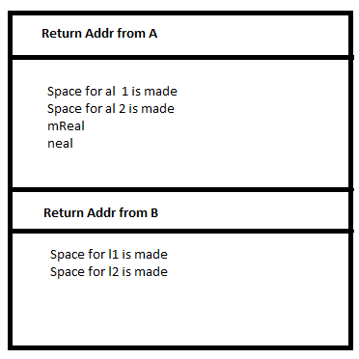
All before B runs E.G.
Fnc A(x,y){
locals
al1
al2
Call fnc B(mReal, nReal)
.
.
} // A ends
Fnc B(x,y){
locals
l1
l2
} // B ends

Slide 8
B Runs
B is a callee, so all callee regs are saved
B runs
Restore all callee regs
Put return value in register
Pop the stack (SP is now at the bottom of A)
brX30 (break)

